Slide 1
Modelling Inhomogeneous Geodata Quality in a Dataset‘s Metadata
Arne Rümmler (arne.ruemmler@tu-dresden.de)
AGILE 2022

Slide 2
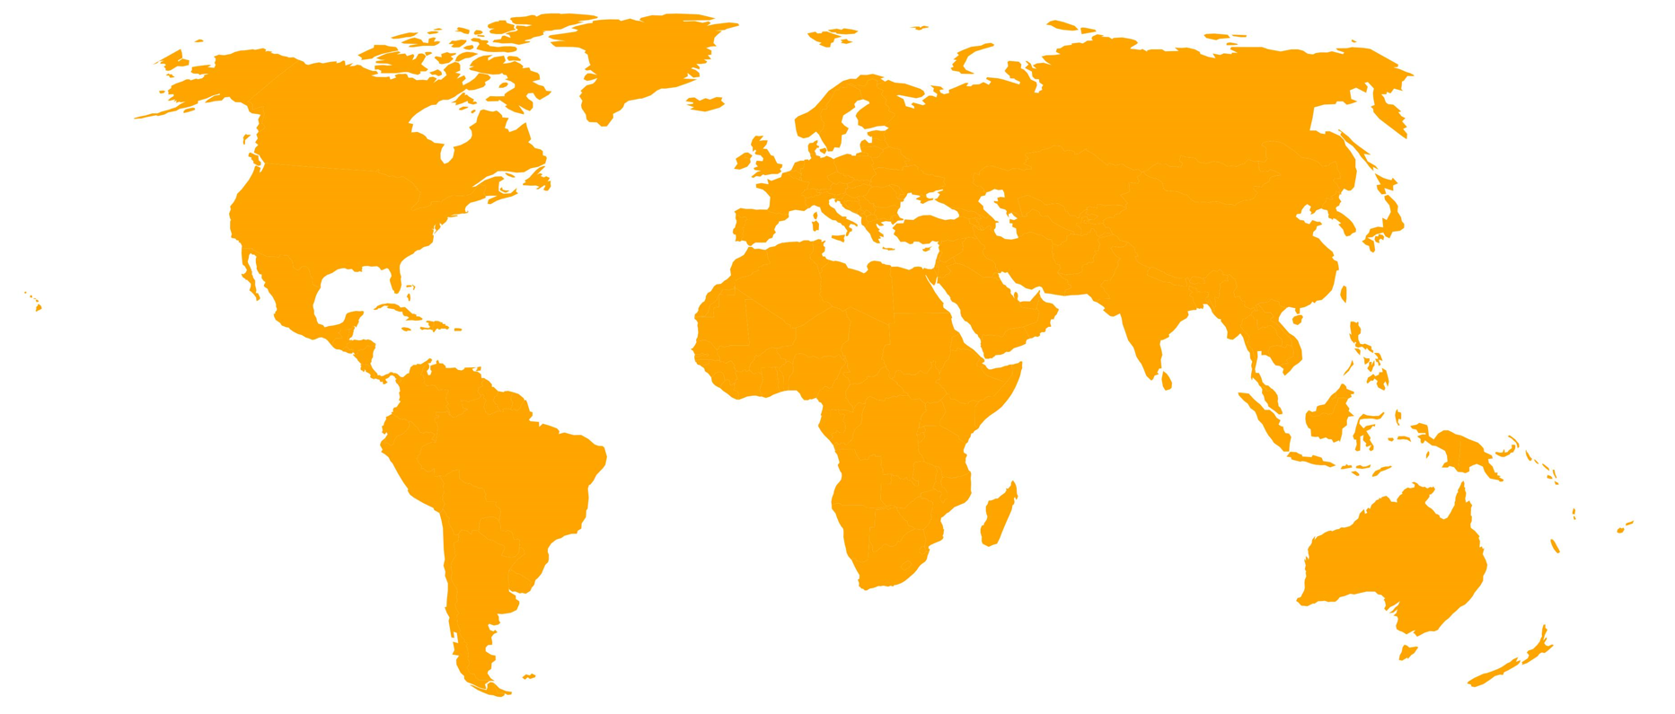
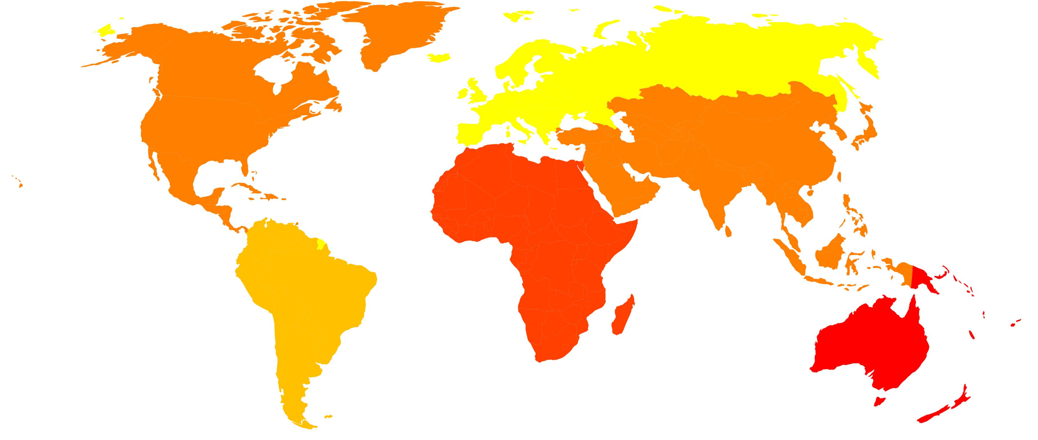
Use Case
A data user wants to conduct a study in Europe
Among other things an input dataset on land use with a user’s accuracy > 90 % is required (user’s accuracy: number of pixels correctly identified as being in a given class divided by the total number of pixels assigned to that class)
Query: DS with larger spatial coverage && user’s acc. <= 90 % are excluded from results; even if user’s acc. > 90 % in study area
Proposed DQV Extension allows data producers to describe inhomogeneous data quality distributions in a dataset’s metadata
-> more incentive to provide extensive DQ information

Slide 3
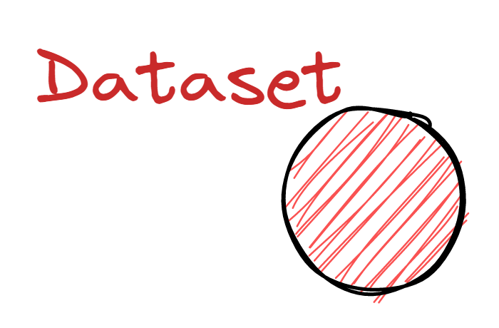
Data Quality Vocabulary (DQV)

Slide 4
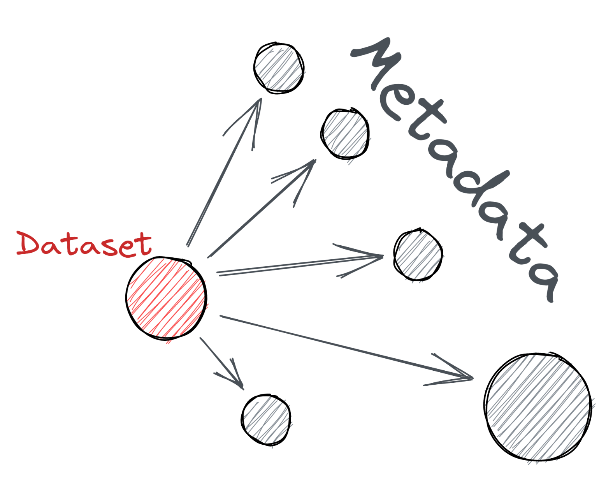
Data Quality Vocabulary (DQV)

Slide 5
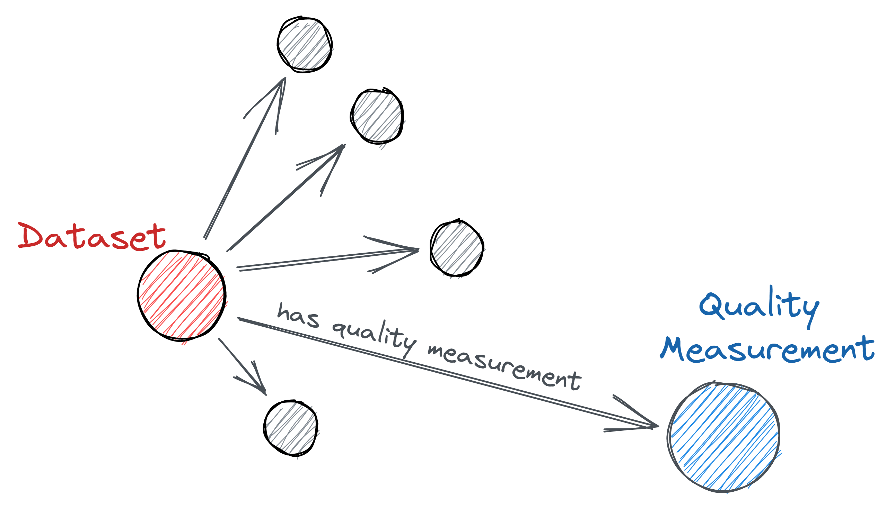
Data Quality Vocabulary (DQV)
A measurement of data quality can be part of a dataset’s metadata

Slide 6
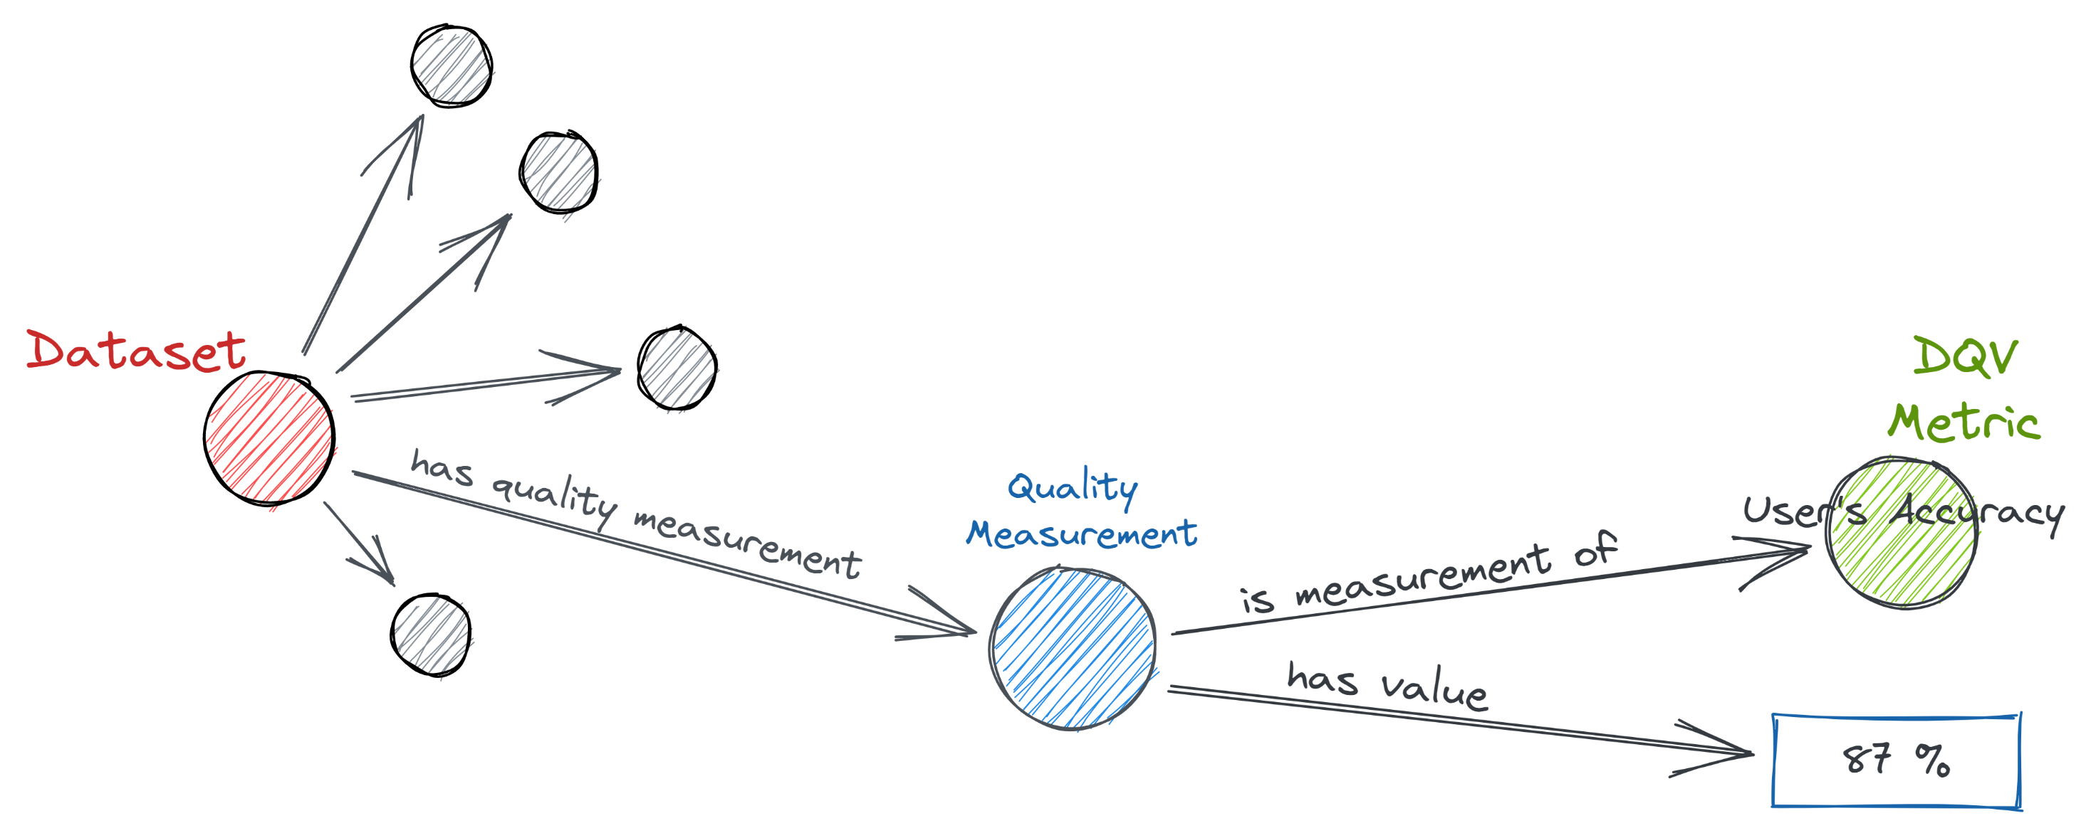
Data Quality Vocabulary (DQV)
A quality measurement measures a certain data quality indicator which yields a value in a specified unit

Slide 7
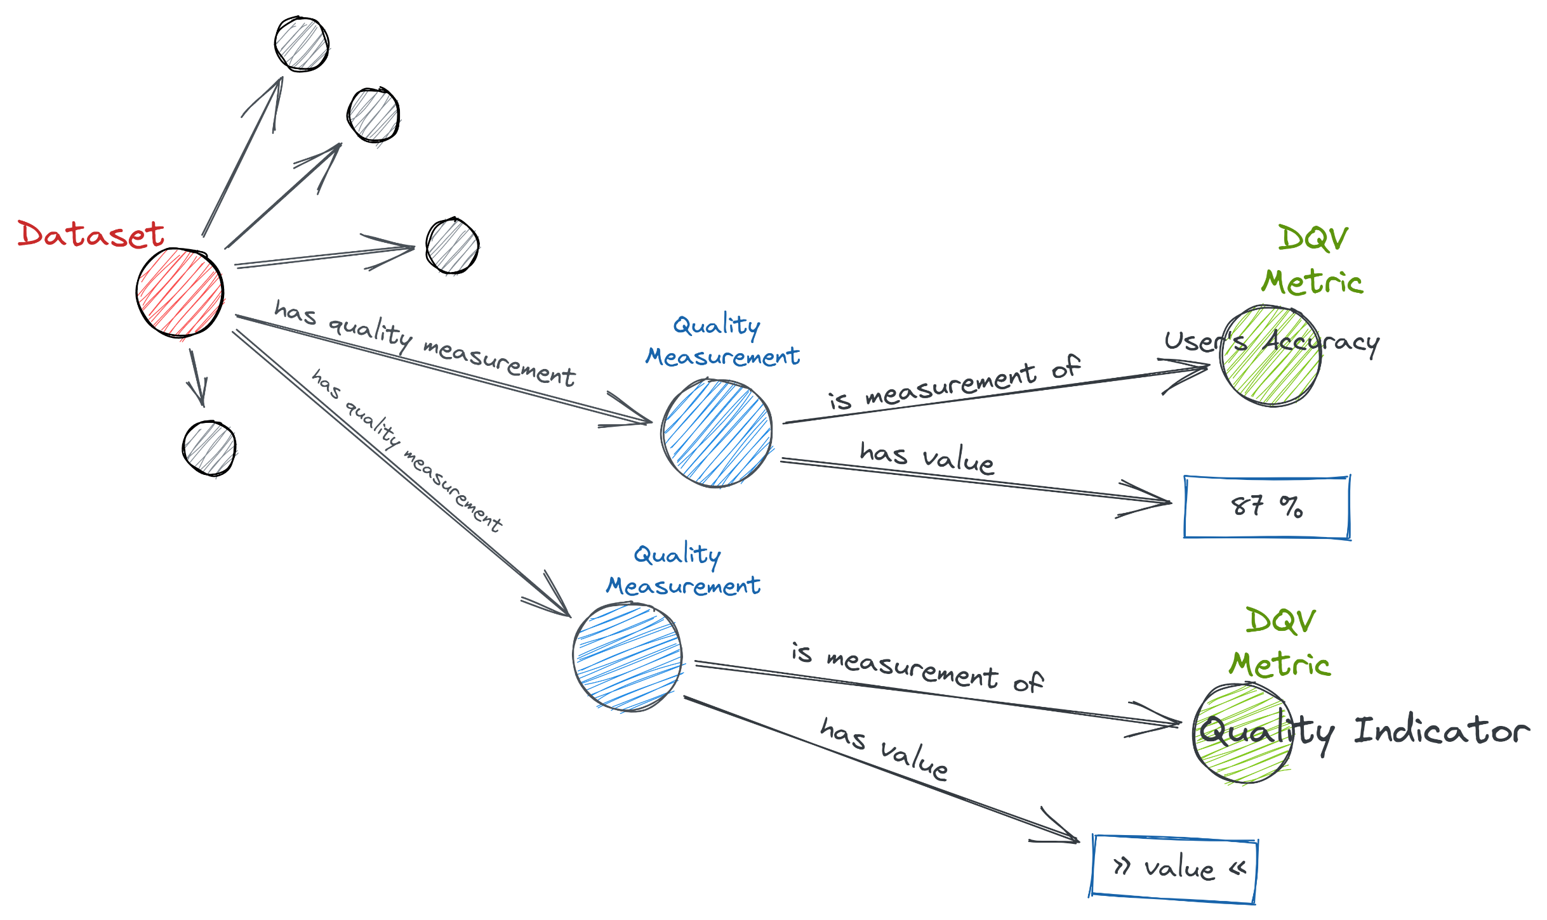
Data Quality Vocabulary (DQV)
A dataset can have n quality measurements for n quality indicators

Slide 8
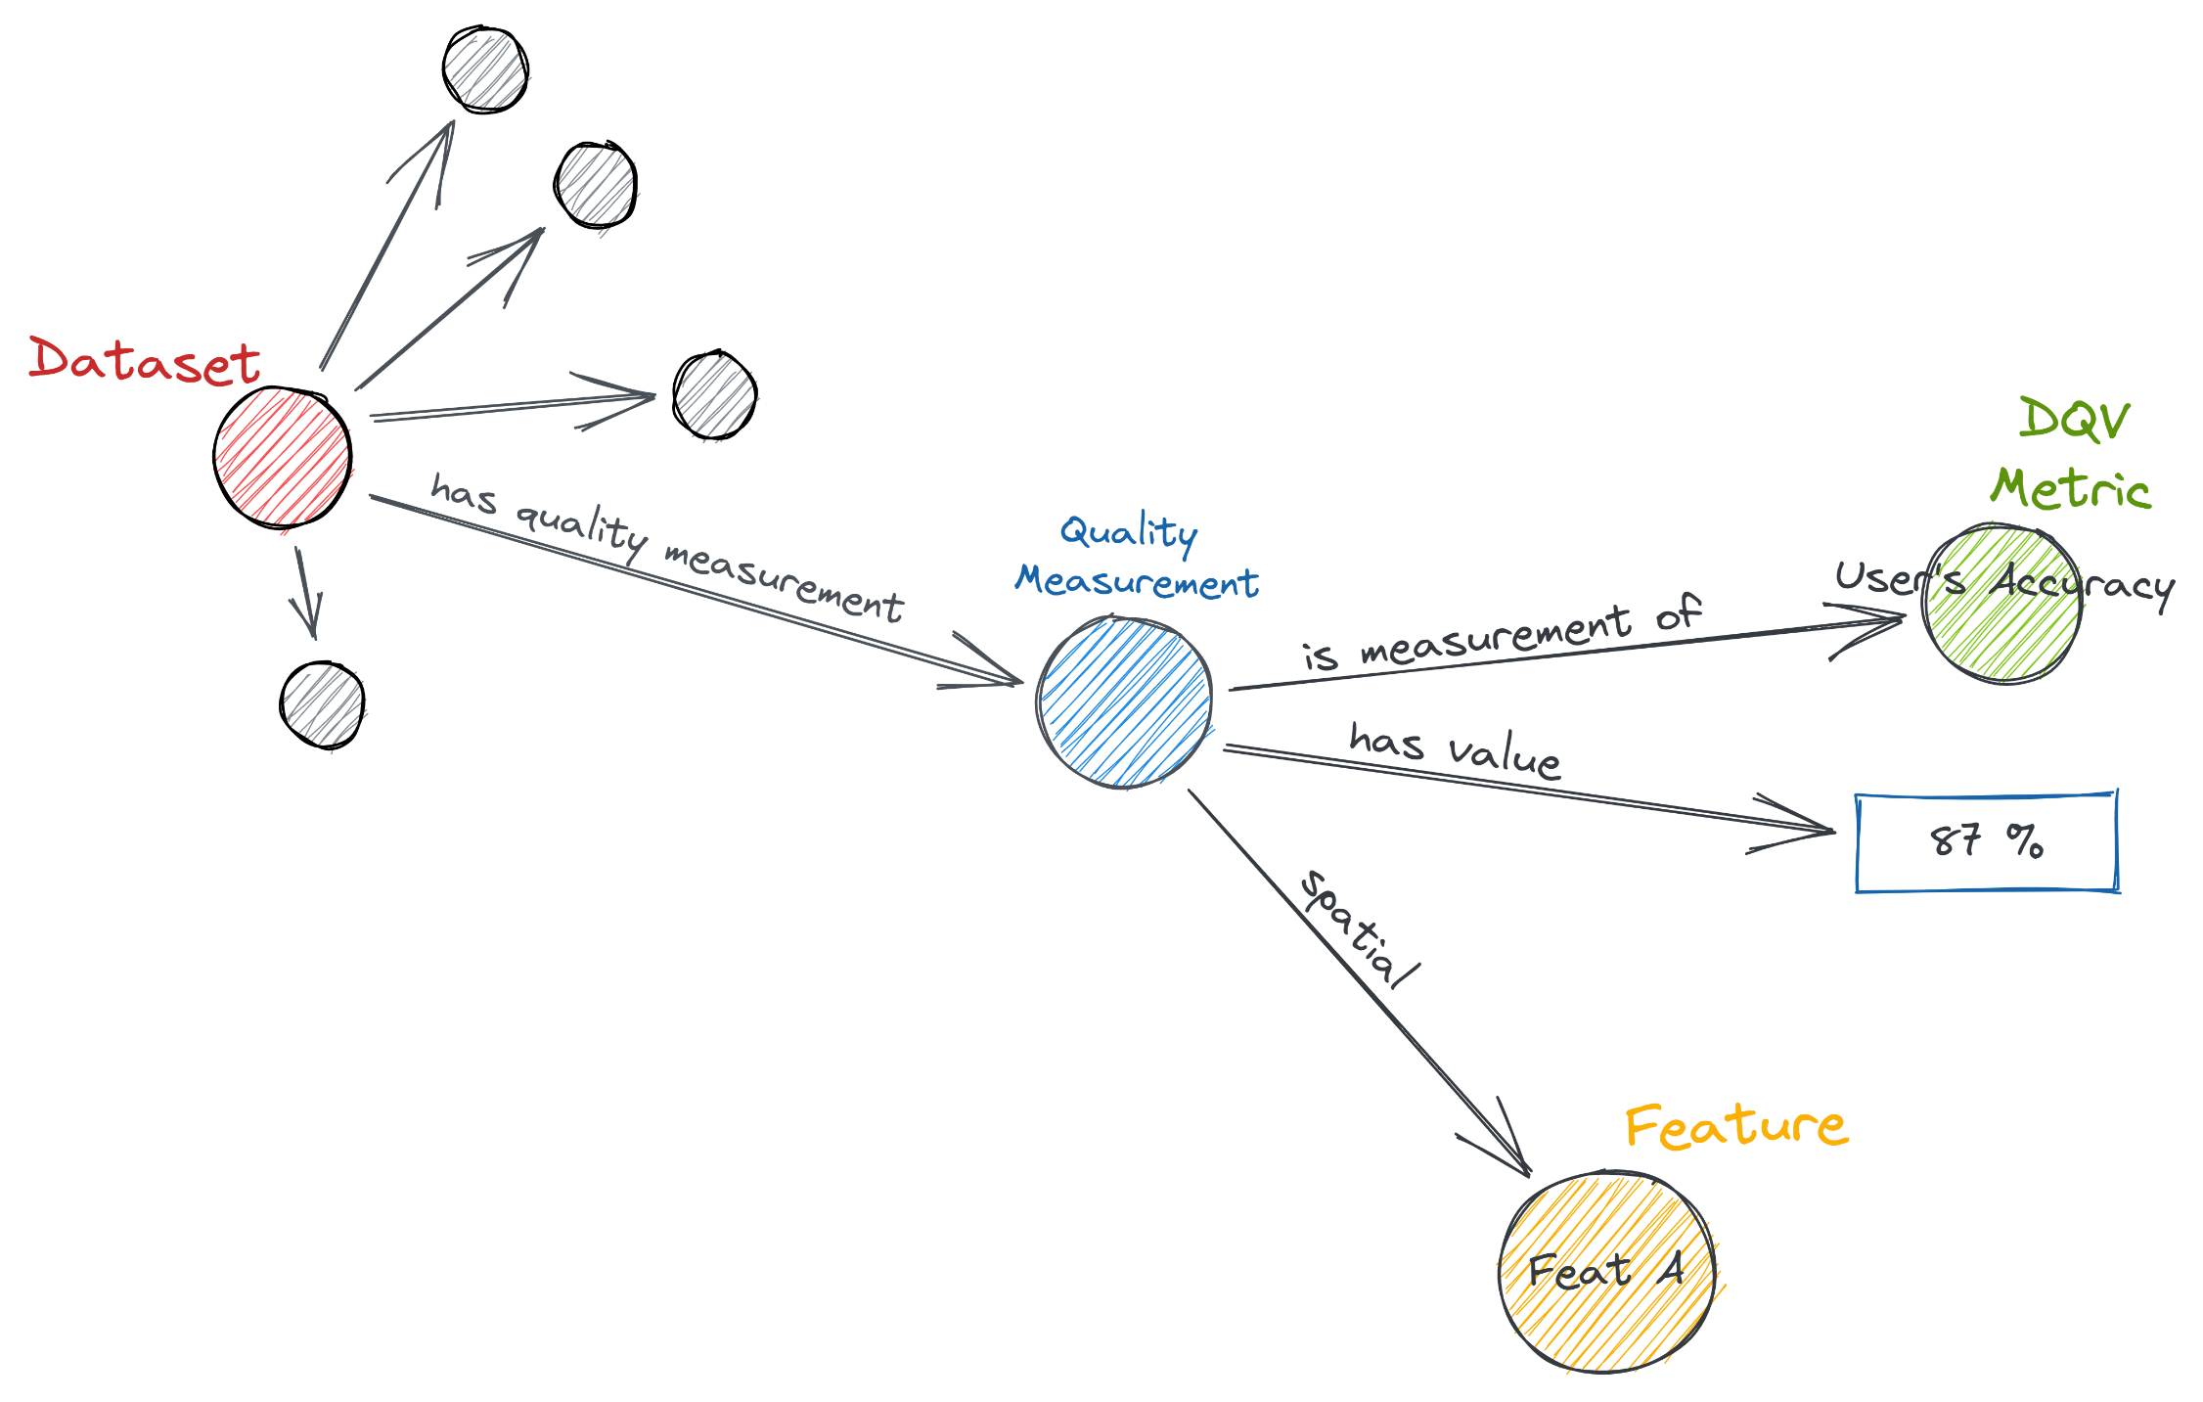
DQV Extension
Assign a quality measurement with a feature that delimits its validity spatially

Slide 9
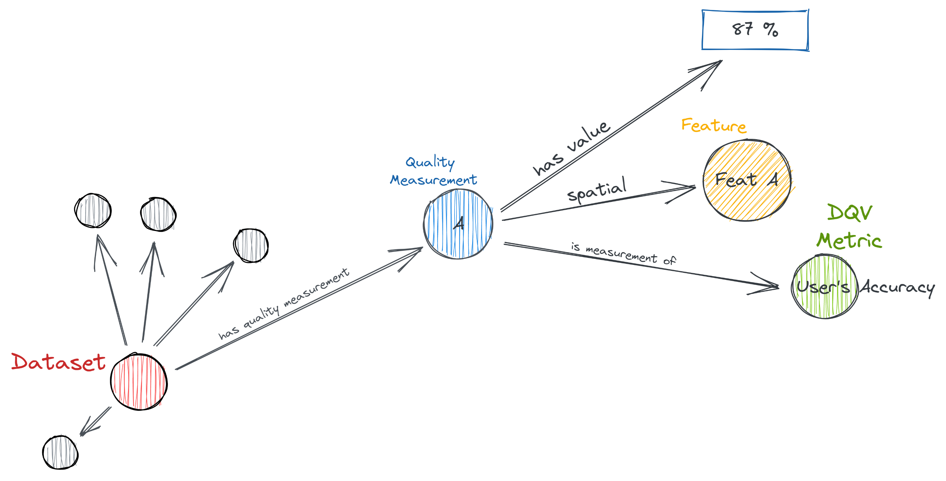
DQV Extension
(Same content as slide before, but rearranged)

Slide 10
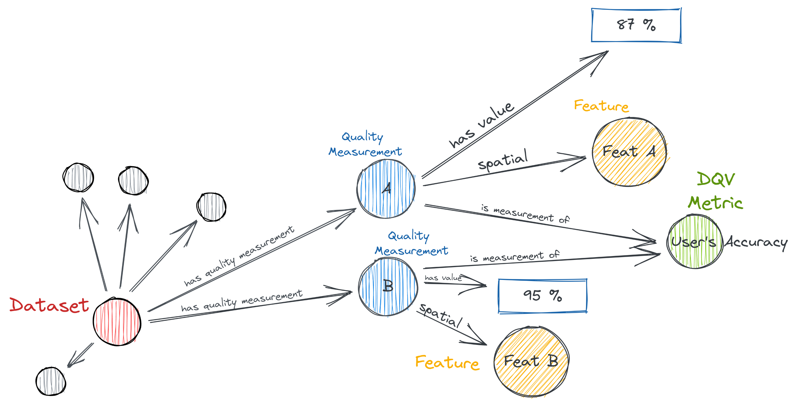
DQV Extension
A dataset can have > n quality measurements for n quality indicators
Each quality indicator can be measured n times

Slide 11
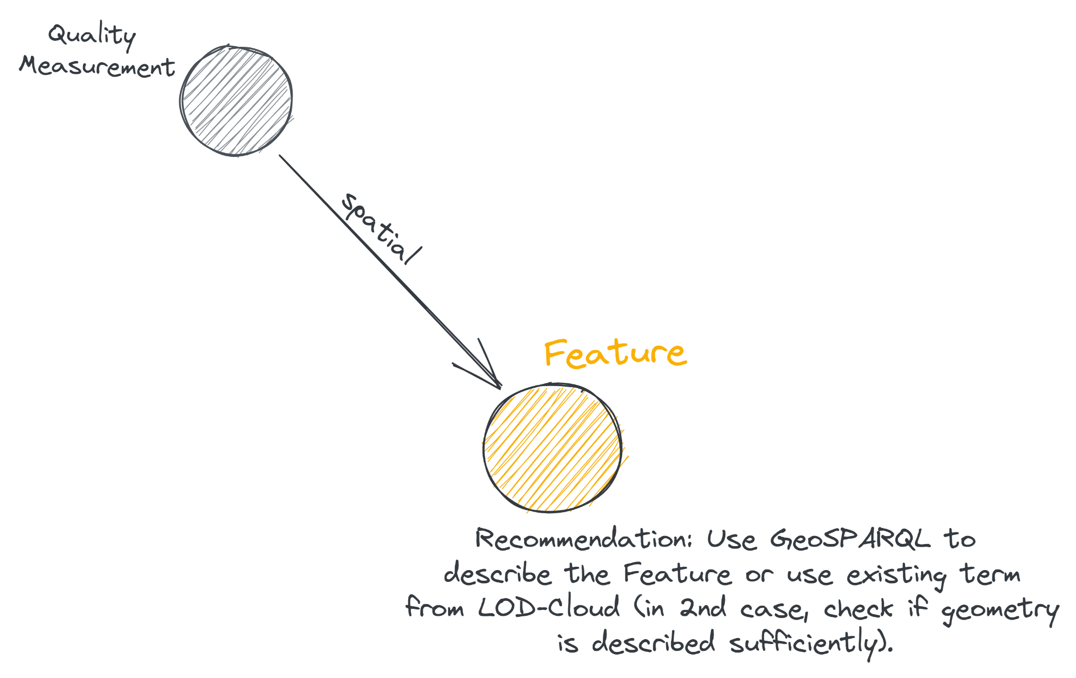
DQV Extension – Spatial Constraining

Slide 12
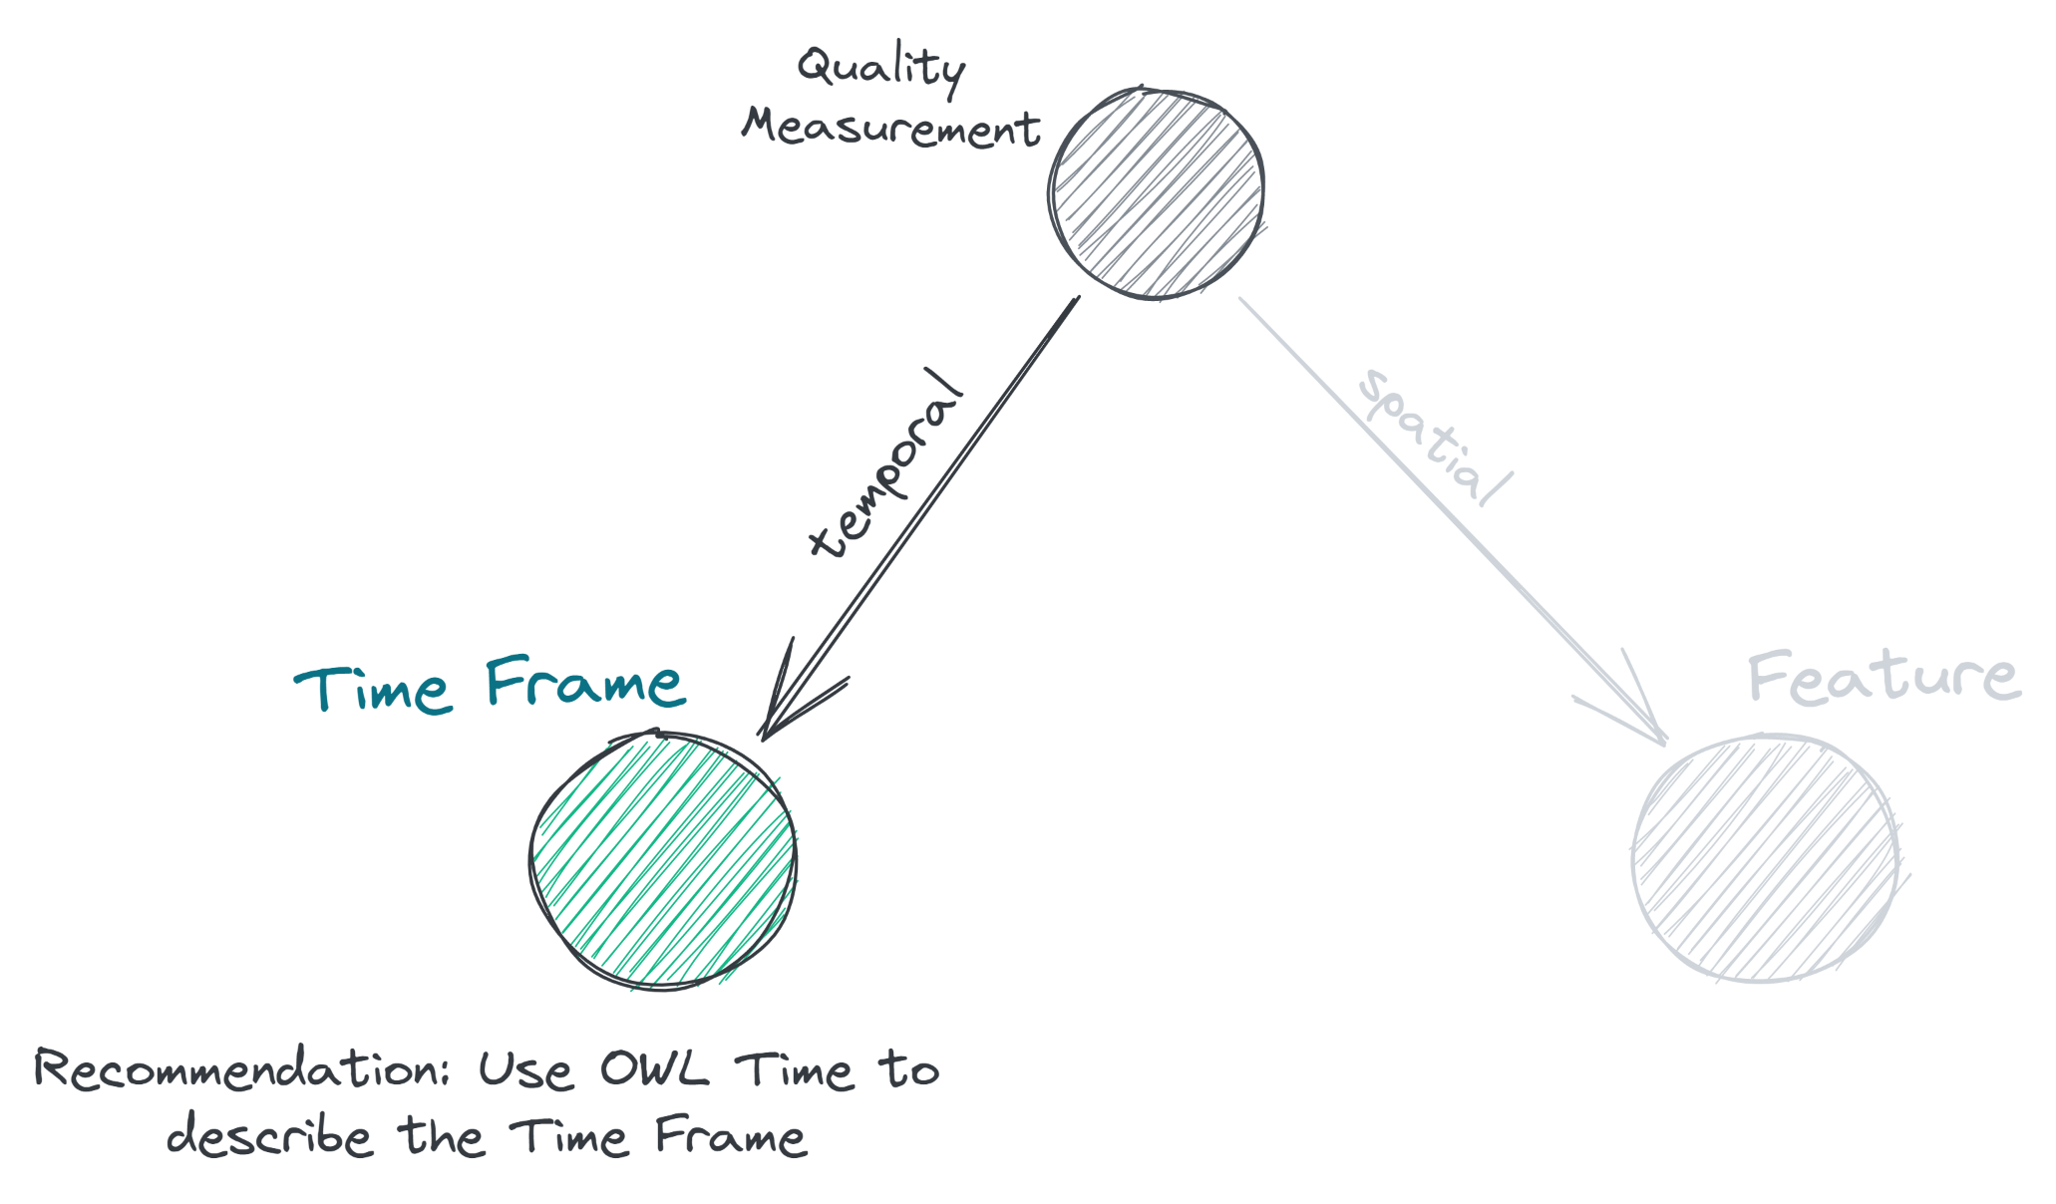
DQV Extension – Temporal Constraining

Slide 13
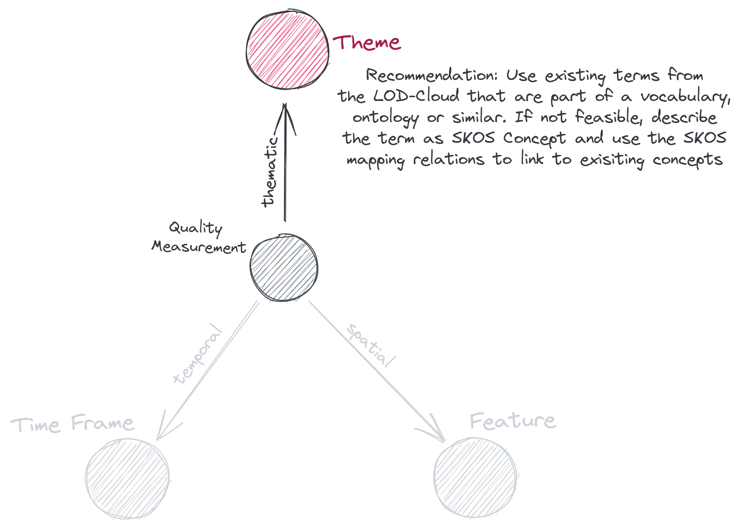
DQV Extension – Thematic Constraining

Slide 14
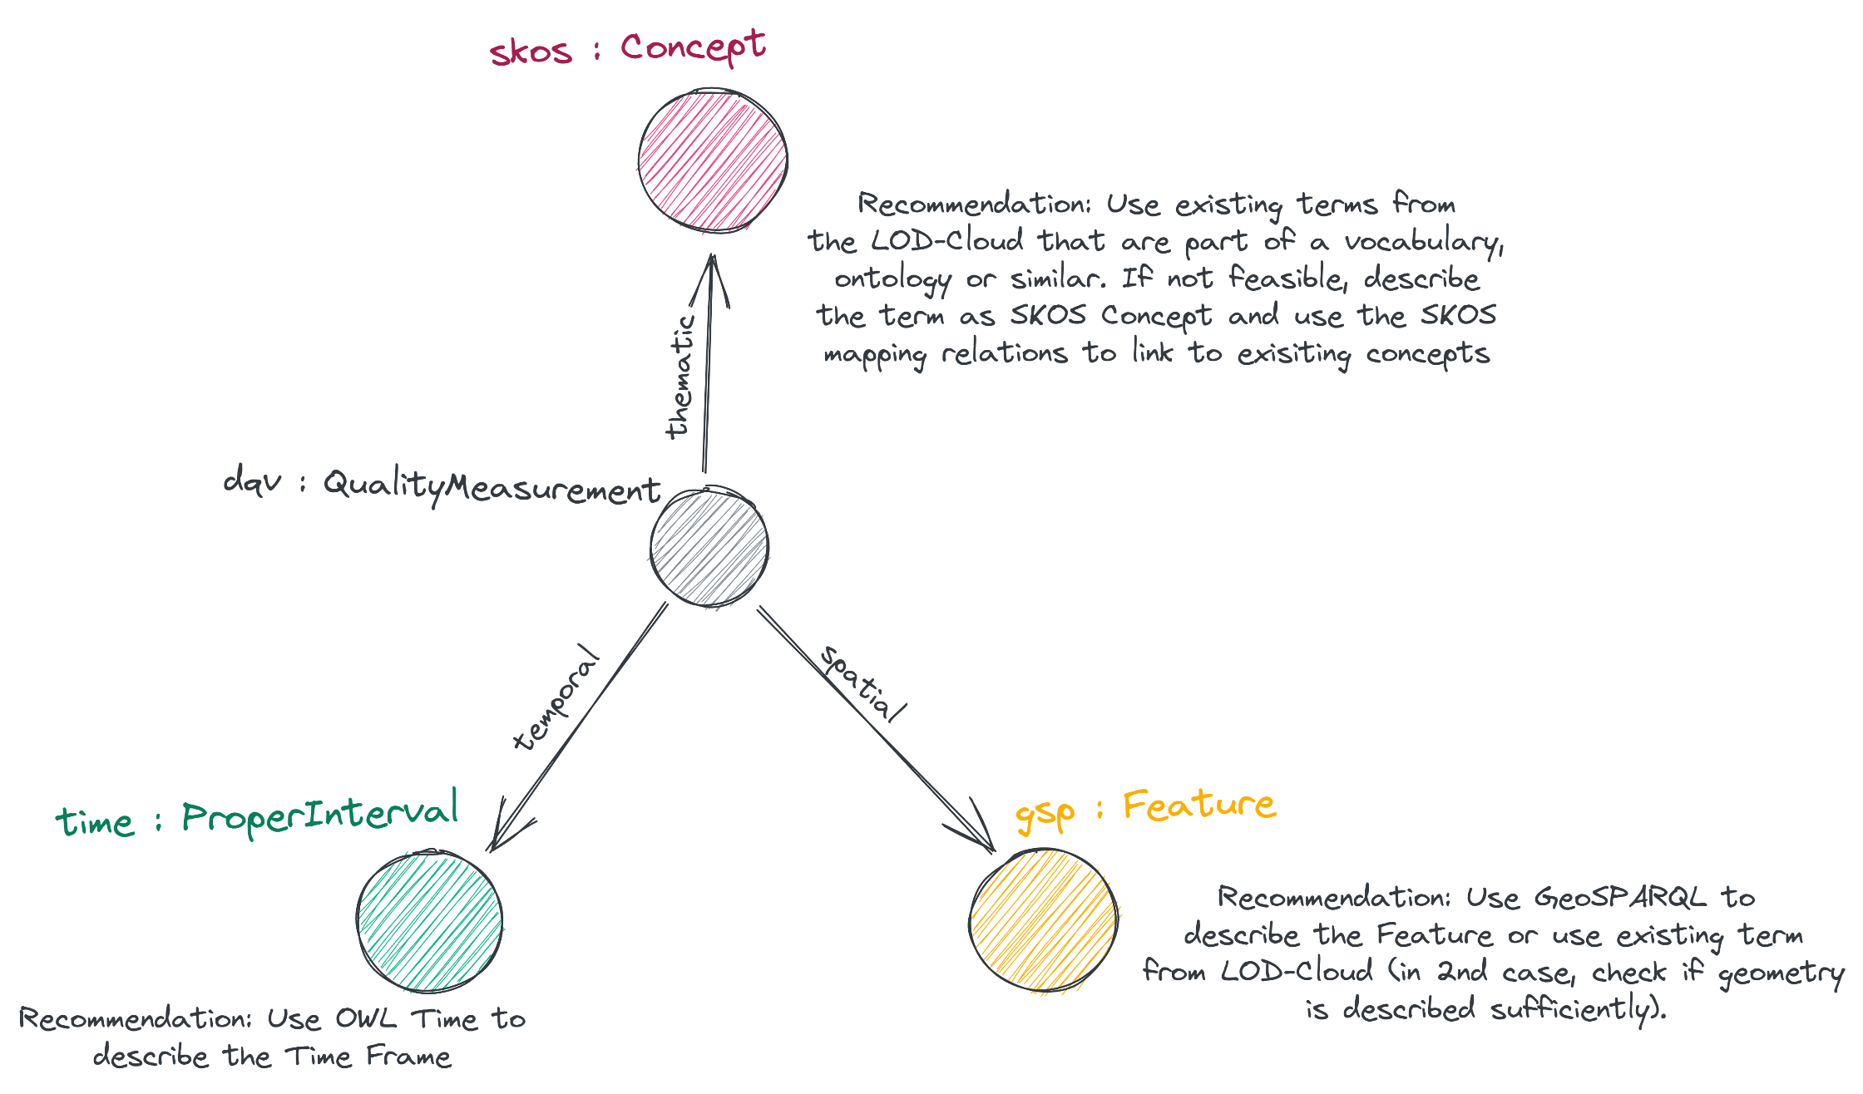
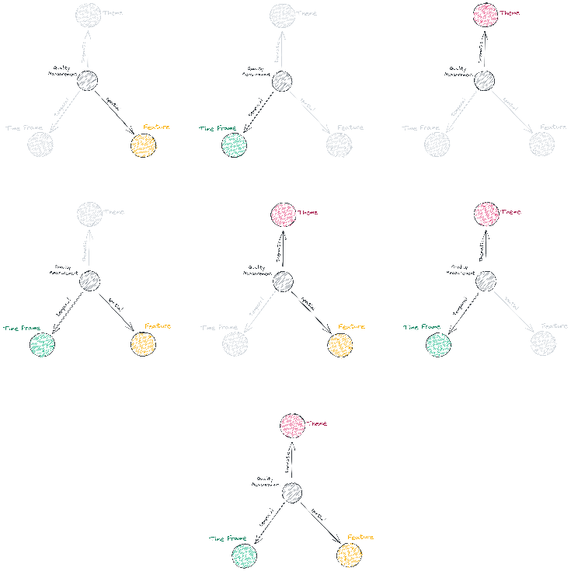
DQV Extension

Slide 15
Comments / Questions / Issues
Related Content
Gerrymandering
Provide provenance and ensure reproducibility
Get constraints by cluster analysis
Availability of DQ information
Shortpaper: https://doi.org/10.5194/agile-giss-3-59-2022
GitHub repository: https://github.com/rue-a/dqv_inhomogeneity
ISO 19159 quality indicators (subset) implemented with DQV: https://geokur-dmp2.geo.tu-dresden.de/fuseki/geokur_quality_register/sparql
Visualization of quality indicators from link on top: https://rue-a.github.io/geokur-quality-register-browser/ [source code: https://github.com/rue-a/rdf_viz]
Global Forest Change DS (Hansen 2013) – A dataset with inhomogeneous DQ that described in a supplementary PDF. Parts of this dataset’s quality metadata are described with this extension and are available in the GitHub repository.
Article: https://www.science.org/doi/10.1126/science.1244693
Supplements: https://www.science.org/doi/suppl/10.1126/science.1244693/suppl_file/hansen.sm.pdf

